Slide 1
An Era of Regionalization? Liesbet Hooghe VU University Amsterdam University of North Carolina at Chapel Hill Gary Marks, Sandi Chapman, Arjan H. Schakel, Sara Niedzwiecki, Sarah Shair-Rosenfield
Notes:
Research Gary and I have been engaged in about estimating regional authority in a reasonably robust way across a large number countries.
One part was done and published in a 2010 book. Working hard to extend this to other countries, and while the data are not complete yet, I would like to give you a first look at this.

Slide 2
Research Program
Regional governance
Time series (1950-2010)
44 countries in OECD, EU, CEEC+
27 Latin American countries
5 Asian countries
International governance
Time series (1950-2010)
72 IOs
Notes:
This project has two parts – MLG beneath and above the state
There is a lot of work on regions as meaningful spaces for politics and policy. Raises some interesting questions:
How much change, how much variation, and how to unpack. What are the elements of variation
Problem of decentralization – lumping together levels and dimensions of authority dispersion.
Problem of dyads in IGOs, no unpacking of authority
They compress regional and local architecture into a centralization/decentralization dichotomy. Such measures tap the extent to which the national state monopolizes authority, but they do not tell us how government below the national level is structured. They conceive government within countries in unidimensional terms as the “other,” the “not central state.” Centralization/decentralization measures, no matter how accurate, are ill-suited for inquiry into the scale and structure of government below the national state
Regularities that characterize the structure of governance from the national to the local level may become invisible when pressed into a unidimensional measure.
Brancati’s measure (2006) scores eight countries for 1985 to 2000, Vernon Henderson’s measure (1999) has eight time points, and Hooghe/Marks’ measure (2001) has four decade-interval time points.
Limitations of data have biased theory and theory testing to cross-sectional analysis in which government structure is assumed to be invariant over time. The most comprehensive quantitative survey to date of the consequences of government structure for efficient public policy, political participation, democratic stability, and the incidence of human rights abuse, notes that “as there is little variation over time in governance indicators . . . panel regressions are inapprorpriate: valid inferences are only available from the sample’s cross-section variation” (Inman 2008, 15).
THE PLAGUE OF THE DYADS.
NOT DYADS!!!
The most widely used sources of data on international organization provide counts of membership of international governmental organizations (IGOs) for individual states and counts of IGO memberships that are common across dyads of states (Singer and Wallace 1970 with multiple updates, e.g. Pevehouse, Nordstrom and Warnke 2004).[1] The first source of data allows one to chart the number of IGO memberships for up to 226 states from the nineteenth century to the present. The second source of data reveals, for the same period, the number of common IGOs memberships for all state dyads, of which there are almost half a million. In recent years, researchers have begun to break away from monistic and dyadic units of analysis by coding networks of states, defined as sets of states connected by alliances, trade networks, and international organizations (Hafner-Burton and Montgomery 2006).
This approach to data collection has proved useful for the study of international cooperation, but it provides almost no information about the structure of international governance because it treats international organizations as homogenous units of analysis. Epistemologically these data are state-centric: variation in international governance is reduced to variation in the incidence of state membership.
Gartzke, Boehmer, and Nordstrom [1] Information is derived from the Yearbook of the Union of International Associations (UIA), a non-profit organization established in 1910 which collects basic information on some 40,000 international governmental and non-governmental bodies (http://www.uia.org).

Slide 3
Characteristics of available datasets
Notes:
Two kinds of datasets:
Substantive datasets –rudimentary, out of date and/or not time series, western
Fiscal data sets – fuller time series, but one dimension (spending and revenues)
Number of dimensions x intervals + time series + regional-level data
Arzaghi-Hend + Brancati: relatively refined measures, but case selection and limited time series
Panizza, Sorens: most refined + time series, but biased (spending data!)

Slide 4
Measurement challenges
Temporal, nuanced, concrete, transparent
regional authority ≠ constant for each country
regional authority ≠ regional spending
regional authority ≠ federalism
Notes:
Concrete = bring it down to meaningful and observable distinctions
Transparent = can be improved
Regional authority ≠ spending oecd/imf
A league table for share of government revenue suggests this. Canada and the United States, where subnational governments have extensive discretion in setting base and rate of taxes, are at the top, but they are followed by Ireland, Finland, Germany, and Sweden—where subnational governments are much more constrained in determining the level and composition of the taxes they receive. Spain and Belgium would face relegation if this were a football league.
Here is an instance where the reliability of the data, which is high, is no guide to their validity, which is low. The correlation between subnational tax revenues as a percentage of all taxes with a measure of tax discretion is 0.19 (p = 0.46, n = 19).
regional authority ≠ decentralization
They conceive government within countries in unidimensional terms as the “other,” the “not central state.” Centralization/decentralization measures, no matter how accurate, are ill-suited for inquiry into the scale and structure of government below the national state.
local versus regional
Germany: Kreise, Regierungsbezirke, Laender.
regional authority ≠ federalism
variation among federal countries: Austria v. different from Germany.
Same among unitary countries: UK, France.
regional authority ≠ constant for each country
Cross-sectional analysis in which government structure is assumed to be invariant over time.
as there is little variation over time in governance indicators . . . panel regressions are inappropriate: valid inferences are only available from the sample’s cross-section variation” (Inman 2008, 15).

Slide 5
Regional governance
Intermediate level with population > 150,000 or any region with special status
General-purpose
Formal authority
Self-rule and shared rule
Notes:
Decisions to make

Slide 6
Institutional depth
Policy scope
Self rule
Fiscal autonomy
Borrowing
REGIONAL AUTHORITY
Representation
Law making
Executive control
Shared rule
Fiscal control
Constitutional reform
Notes:
Find levers to break authority down.
Clearly articulated institutional intervals
First step = conceptual. Notion of self rule / shared rule in federalism literature.
Territorial scope, spheres of action, depth of authority
But extended to all countries

Slide 7
Notes:
2010 book

Slide 8
Notes:
Change in democracy, democratization – let the chips fall where they may, self-rule for subnational communities
Population differences – powerful predictor of extent of authority – deep functional element
Level of development – diversification of policy portfolio (+ role of international organizations)

Slide 9
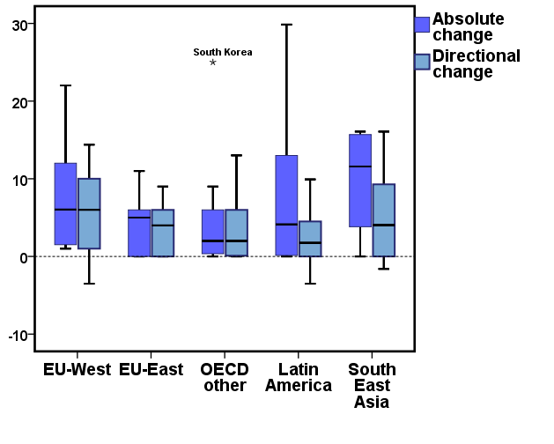
Notes:
There has been quite a lot of change, but while in OECD nearly all this change has been towards strengthening regional authority. The pattern is quite different in LA and SEA, where there has been a lot of centralization as well as decentralization. In each region: 2010 is more decentralized than 1950, but the journey from A to B has been quite different.
Why do you increase the N? In part to examine whether there is greater variation in the dependent variable (regional authority). But the main reason is to examine the effect of greater variation in the independent variables, and you can see this here – something has got to account for the different trajectories. Democracy!

Slide 10
Top seven in absolute change |  | Top seven in directional change
Argentina | 29.9 | Indonesia | +16.1
South Korea | 25.0 | Italy | +14.4
Belgium | 22.0 | Belgium | +14.1
Ecuador | 20.5 | South Korea | +13.0
Peru | 20.1 | Spain | +12.1
Brazil | 20.0 | France | +10.0
Italy | 16.4 | Bolivia | +9.9

Slide 11
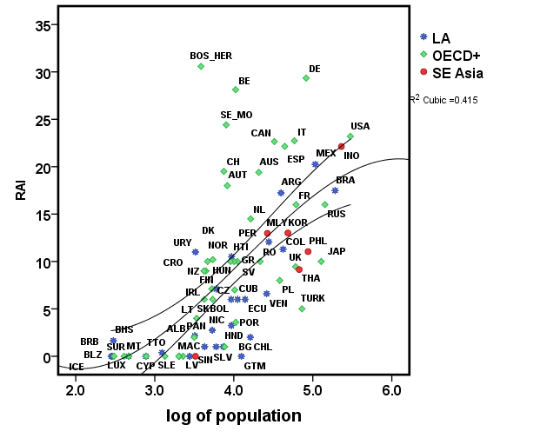
SCALE:
POPULATION
SIZE
Notes:
Population

Slide 12
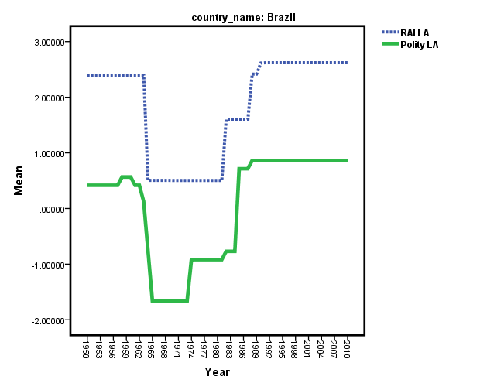
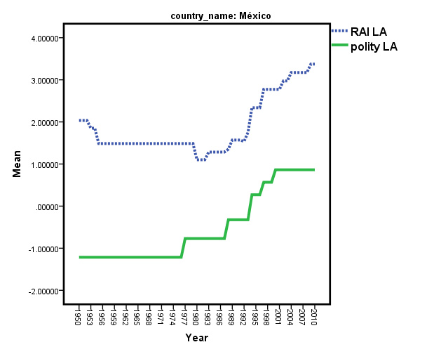
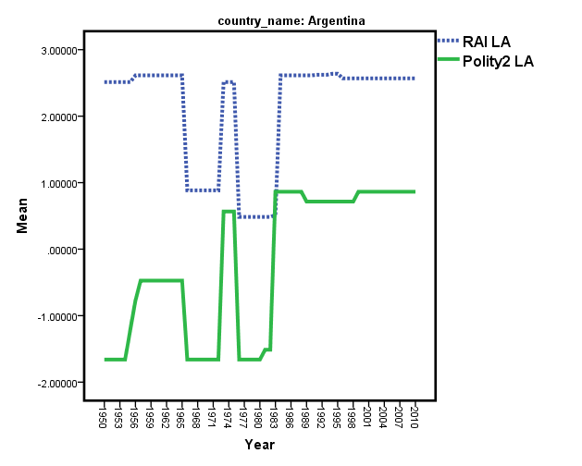
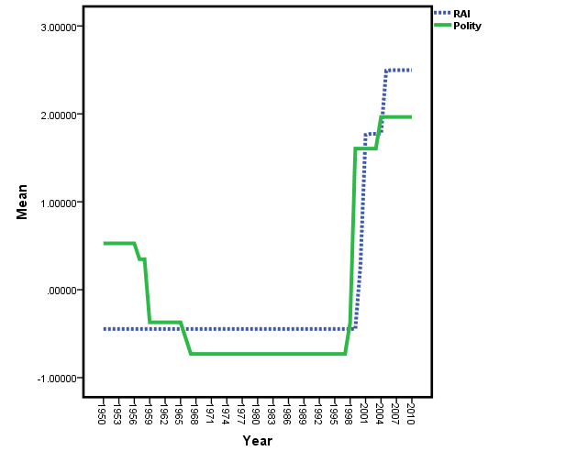
DEMOCRACY
Brazil
Mexico
Argentina
Indonesia
Notes:
Two elements:
Regional authority tracks regime change
Federalism does not protect against scaling back authority
Estimate of regionalization is distinct from authoritarianism/ democracy

Slide 13
 | 81 countries | 42 OECD+ | 41 LA+SEA
Population | .590*** | .550*** | .604***
Area | .003 | .124** | .038
Ethnic fragmentation | .145*** | .305*** | .081***
Affluence | .069*** | .023 | .031*
Democracy | .167*** | .272*** | .192***
R² | .45 | .51 | .49

Slide 14
Council of Europeanists’ Territorial Politics and Federalism Listserve
CES-TPF
https://lists.columbia.edu/mailman/listinfo/ces-tpf
Contact: Michael Tatham (tatham.michael@gmail.com)

Slide 15
Self Rule: The authority exercised by a regional government over those who live in the region
Institutional depth | The extent to which a regional government is autonomous rather than deconcentrated. | 0–3
Policy scope | The range of policies for which a regional government is responsible. | 0–4
Fiscal autonomy | The extent to which a regional government can independently tax its population. | 0–4
Borrowing | The extent to which a regional government can borrow money | 0-3
Representation | The extent to which a region is endowed with an independent legislature and executive. | 0–4
Shared Rule: The authority exercised by a regional government or its representatives in the country as a whole
Law making | The extent to which regional representatives co–determine national legislation. | 0–2
Executive control | The extent to which a regional government co–determines national policy in intergovernmental meetings. | 0–2
Fiscal control | The extent to which regional representatives co–determine the distribution of national tax revenues. | 0–2
Constitutional reform | The extent to which regional representatives co–determine constitutional change. | 0–3

Slide 16
 | Institutional Depth
0: | no functioning general-purpose administration at the regional level;
1: | deconcentrated, general-purpose, administration;
2: | non-deconcentrated, general–purpose, administration subject to central government veto;
3: | non-deconcentrated, general–purpose, administration not subject to central government veto.
 | Policy Scope
0: | very weak authoritative competencies in economic policy, cultural-educational policy, welfare policy;
1: | authoritative competencies in a), b), c) or d) a) economic policy, b) cultural-educational policy, c) welfare policy; d) one of the following: residual powers, regional police force, own institutional set–up, local government
2: | authoritative competencies in at least two of a), b), c), d);
3: | authoritative competencies in d) and at least two of a), b), c)
4: | criteria for 3 plus authority over immigration or citizenship.

Slide 17
 | Fiscal Autonomy
0: | the central government sets the base and rate of all regional taxes;
1: | the regional government sets the rate of minor taxes;
2: | the regional government sets the base and rate of minor taxes;
3: | the regional government sets the rate of at least one major tax: personal income, corporate, value added, sales tax;
4: | the regional government sets the base and rate of at least one major tax.
 | Borrowing
0: | no borrowing or rules prohibiting borrowing;
1: | borrowing allowed if ex ante clearance (e.g. requires prior administrative approval)
2: | borrowing allowed if consistent with general restrictions (e.g. ceiling, only domestic, conditions set in law; random post-hoc checks)
3: | no restrictions (market-based mechanism)
 | Representation: Assembly
0: | the region has no regional assembly;
1: | the region has an indirectly elected regional assembly;
2: | the region has a directly elected assembly.
 | Representation: Executive
0: | the regional executive is appointed by central government;
1: | dual executive appointed by central government and the regional assembly;
2: | the executive is appointed by a regional assembly or is directly elected.

Slide 18
 | Law Making
0.5 for each of the following characteristics:
▪ | regions are the unit of representation in the legislature, i.e. the distribution of representation is determined by regional weights, rather than 'one citizen, one vote' in the country as a whole;
▪ | regional governments designate representatives in the legislature;
▪ | regions at a given level have majority representation in the legislature;
▪ | a legislature with regional representation has extensive legislative authority, i.e. can veto ordinary legislation or can be overridden only by a supermajority in the other chamber
 | Executive Control
0: | no routine meetings between central government and regional governments to negotiate policy;
1: | routine meetings between central government and regional governments without legally binding authority;
2: | routine meetings between central government and regional governments with authority to reach legally binding decisions.
 | Fiscal control
0: | regional governments or their representatives in the legislature are not consulted over the distribution of tax revenues;
1: | regional governments or their representatives in the legislature negotiate over the distribution of tax revenues, but do not have a veto;
2: | regional governments or their representatives in the legislature have a veto over the distribution of tax revenues.

Slide 19
 | Constitutional Reform
0: | the central government and/or national electorate can unilaterally change the constitution;
1: | a legislature on the principle of regional representation must approve constitutional change; or constitutional change requires a referendum based on equal regional representation (i.e. approval in a majority of regions);
2: | regional governments are a directly represented majority in a legislature which can do one or more of the following: ▪ postpone constitutional reform ▪ introduce amendments ▪ raise the decision hurdle in the other chamber ▪ require a second vote in the other chamber ▪ require a popular referendum
3: | a majority of regional governments can veto constitutional change.

Slide 20
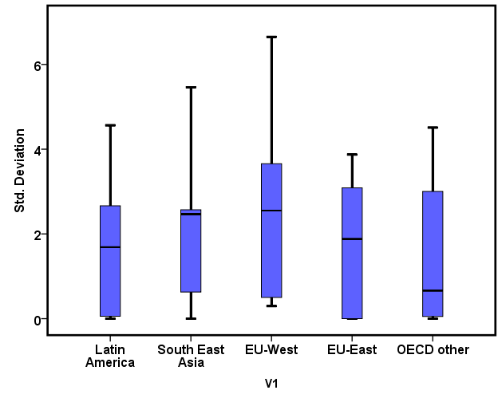
Notes:
Boxplot of std in RAI for each country (change over time by country).

