Slide 1
Knowledge | Networks | Space Delft, 14 May 2012
Networks
Space
Knowledge
Prof. Dr. Johannes Glückler
Chair for Economic and Social Geography
Institute of Geography, University of Heidelberg
Email | glueckler@uni-hd.de
Web | www.economic-geography.uni-hd.de
Notes:
Networks understudied, often only rhetoric, recently qualitative theories of networks (e.g. actor-network theory) with non-relational methods
Outside geography many network studies of geography of knowledge without making reference to geography.
Knowledge generation and innovation develop unequally in space, the geography of innovation has received major attention over the last decades.
Knowledge refers to the experience and abilities of people
Networks are important in geography. However,

Slide 2
Buzzwords³
Every 6th session of this conference has ‘network‘ in its title (20/121)
Networks
Every 8th paper of this conference has ‘network’ in its title (44/364).
Space
rank | keyword | count
1 | region* | 256
2 | space* | 85
3 | city/cities | 79
4 | planning | 72
5 | governance | 68
6 | development | 67
7 | network* | 64
8 | innovat* | 62
9 | territor* | 57
10 | knowledge | 48
Knowledge
Number of times that a keyword appears in the 2012 RSA annual conference program

Slide 3
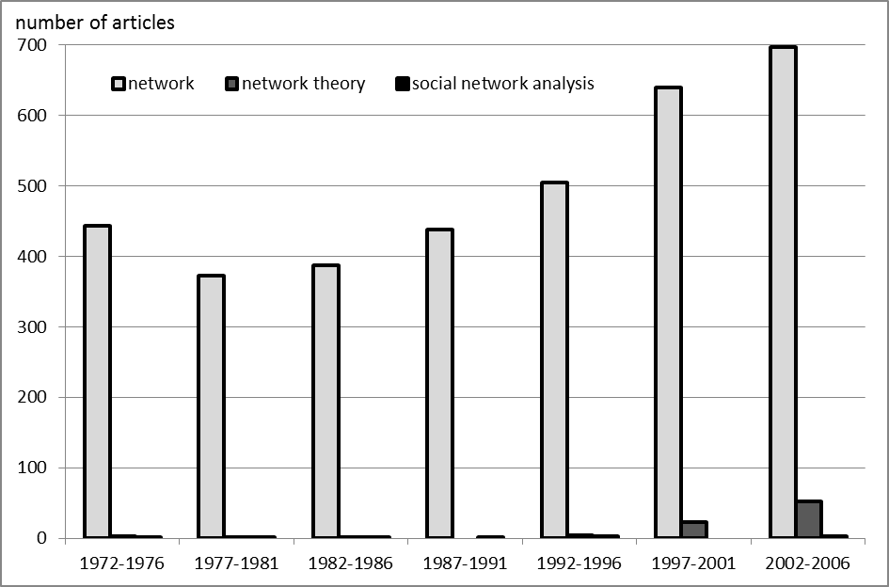
Increasing popularity of networks in geography
Own research based on queries with JSTOR, April 2012

Slide 4
Agenda
What is network theory? Toward a full relational revolution
Network theories of knowledge & geography Contingencies of an explanatory triad
Beyond connectivity Fortifying geography
Conclusion

Slide 5
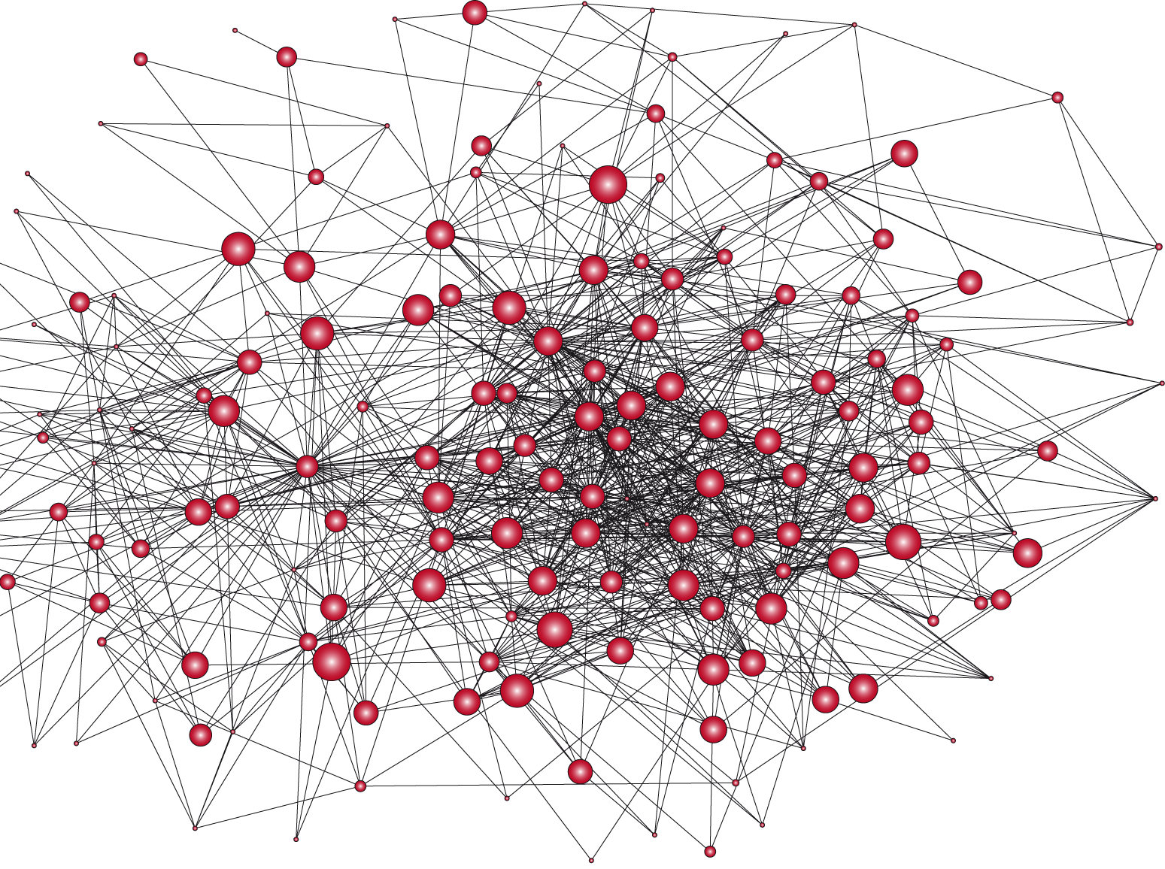
A social network is…
“a specific set of linkages among a defined set of persons, with the additional property that the characteristics of these linkages as a whole may be used to interpret the social behavior of the persons involved”
(Mitchell 1969, 2)
Mitchell, J. C. (1969) The concept and use of social networks. In J. C. Mitchell (ed.) Social Networks in Urban Situations. Analyses of Personal Relationships in Central African Towns. Manchester: Manchester University Press, 1-50.

Slide 6
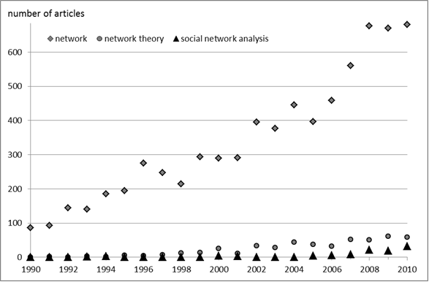
Networks: relational rhetoric, atomistic analysis?
Own research based on queries with EBSCO and individual electronic journal archives, April 2012

Slide 7
What is network theory?
 | Social outcomes
Model | Success | Choice
Flow (ties as pipes) | Capitalization | Contagion
Coordination (ties as bonds) | Cooperation | Convergence
Capitalization = flow-based theories of innovation (e.g. structural holes)
Cooperation = coordination-based theories of innovation (network governance, organized networks)
Borgatti SP, Halgin DS (2011) On network theory. Organization Science:

Slide 8
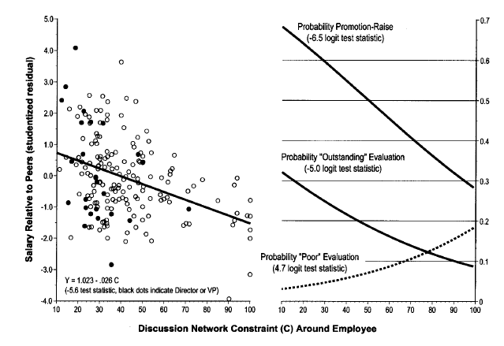
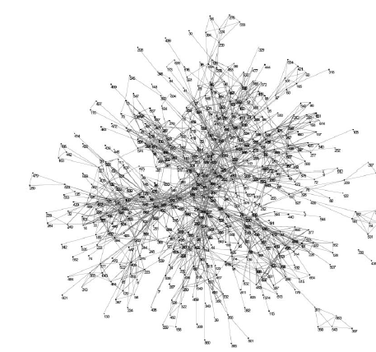
Structural hole theory: contacts and careers
Burt, R. S. (2004): Structural holes and good ideas. American Journal of Sociology 110, S. 349-399.

Slide 9
Network theory and theory of networks
 | Dependent variable
Independent variable | Non-network variable as outcome | network variable as outcome
Non-network variable as antecedent | Non-network theory | (B) Theory of networks
Network variable as antecedent | (A) Network theory | (C) Network theory of networks
Network theory
Example: centrality increases innovativeness
Theory of networks
Example: legitimacy or resource endowment drives centrality
Network theory of networks
Example: Point connectivity predicts future tie formation
Borgatti SP, Halgin DS (2011) On network theory. Organization Science:

Slide 10
Agenda
What is network theory? Toward a full relational revolution
Network theories of knowledge & geography Contingencies of an explanatory triad
Beyond connectivity Fortifying geography
Conclusion

Slide 11
Networks affect knowledge (and innovation)
Existence of ties
Number of ties
Membership in a network
Strength of ties
Strong ties
Weak ties
Position
Centrality
Prestige
Autonomy
Out-group orientation
Between core and periphery
Networks
Space
+
Knowledge
Burt RS (1992) Structural Holes: The Social Structure of Competition. Cambridge (MA), London: Harvard University Press.; Granovetter M (1973) The strength of weak ties. American Journal of Sociology 78: 1360-1380; Krackhardt D, Stern RN (1988) Informal networks and organizational crises: An experimental simulation. Social Psychology Quarterly 51 (2): 123-140; Powell WW, Koput KW, Smith-Doerr L (1996) Interorganizational collaboration and the locus of innovation: networks of learning in biotechnology. Administrative Science Quarterly 41 (1): 116-145

Slide 12
(i) Geography of knowledge
Networks
“intellectual breakthroughs must cross hallways and streets more easily than oceans and continents” (Glaeser et al. 1992: 1126).
Patent citation analyses demonstrate that technological development is sticky to regions.
Space
+
Knowledge
Glaeser EL, Kallal HD, Scheinkman JA, Shleifer A (1992) Growth in cities. The Journal of Political Economy 100 (6): 1126-1152; Jaffe AB, Trajtenberg M, Henderson R (1993) Geographic localization of knowledge spillovers as evidenced by patent citations. Quarterly Journal of Economics 108: 577-598; Thompson P, Fox-Kean M (2005) Patent citations and the geography of knowledge spillovers: A reassessment? American Economic Review 95 (1): 450-460

Slide 13
(ii) Geography affects networks
Networks
A geographical theory of networks (in compliance with Borgatti/Hardin)
Physical proximity increases the likelihood for social relations and information exchange
Research on network evolution confirms geographically nested growth of network linkages on longitudinal data.
+
Space
Knowledge
Allen T (1977) Managing the Flow of Technology: Technology transfer and the Dissemination of Technological Information within the Research and Development Organization. Cambridge, MA: MIT Press. Powell WW, White D, Koput KW, Owen-Smith J (2005) Network dynamics and field evolution: The growth of interorganizational collaboration in the life sciences. American Journal of Sociology 110 (4): 1132-1205; Zipf GK (1949) Human Behaviour and the Principle of Least Effort. Cambridge, Mass.: Addison-Wesley Press.

Slide 14
(iii) Geography moderates network effects on knowledge
Example: Alliances in bio-technology and firm innovative-ness (Owen-Smith/Powell 2004):
Network centrality is an important factor of innovativeness only in the global network, but insignificant in the regional cluster.
Firms connected to the local network have equal propensities to innovate independently from the centrality of their position in the network.
Networks
Space
-
+
Knowledge
Owen-Smith J, Powell WW (2004) Knowledge networks as channels and conduits: The effects of spillovers in the Boston biotechnology community. Organization Science 15 (1): 5-21; Whittington KB, Owen-Smith J, Powell WW (2009) Networks, propinquity, and innovation in knowledge-intensive industries. Administrative Science Quarterly 54 (1): 90-122

Slide 15
(iv) Networks moderate spatial effects on knowledge
Accepted state of knowledge: information transfer and knowledge spillovers decay with geographical distance
Informal and formal networks of relations between distributed organizational units clearly moderate the association between technology transfer and geography
Network relationships help bridging distance
Networks
+
Space
-
Knowledge
Bell GG, Zaheer A (2007) Geography, networks, and knowledge flow. Organization Science 18 (6): 955-972; Glückler J (2006) A relational assessment of international market entry in management consulting. Journal of Economic Geography 6: 369-393; Hansen MT, Lovas B (2004) How do multinational companies leverage technological competencies? Moving from single to interdependent explanations. Strategic Management Journal 25: 801-821

Slide 16
(iv) Networks mediate spatial effects on knowledge
Almeida/Kogut find that spillovers vary across regions and those regions with the strongest spillovers in technological development were the ones where job mobility was most restricted to intraregional job moves.
Rosenkopf/Almeida show that inventor mobility increases inter-firm knowledge transfer (patent citations) independent of geography.
Borgatti/Foster find that when ‘knowing someone’ and ‘accessibility of the person’ are controlled, proximity has no statistical effect on information transfer.
Networks
+
Space
+
0
Knowledge
Mediation implies that the mediated variable (space) predicts the mediating variables as well as the dependent variable (e.g. innovation), and that the coefficient for the mediated variable is insignificant when the mediators are included in the model.
Almeida P, Kogut B (1999) Localization of knowledge and the mobility of engineers in regional networks. Management Science 45: 905-917; Breschi S, Lissoni F (2009) Mobility of skilled workers and co-invention networks: An anatomy of localized knowledge flows. Journal of Economic Geography 9 (4): 439-468; Borgatti SP, Foster PC (2003) The network paradigm in organizational research: A review and typology. Journal of Management 29 (6): 991-1013; Rosenkopf L, Almeida P (2003) Overcoming local search through alliances and mobility. Management Science 49 (6): 751-766

Slide 17
Agenda
What is network theory? Toward a full relational revolution
Network theories of knowledge & geography Contingencies of an explanatory triad
Beyond connectivity Fortifying geography
Conclusion

Slide 18
Accounting for ambivalent evidence
Empirics suggest: Ambivalent evidence about the explanatory triad ‘knowledge, networks and space’
Reason 1: Variance in research designs, methodology and measures
Measures of networks (Level of actors, kinds of relations)
(Lack of) variations in what is conceived as knowledge (patents)
Neglect of intervening conditions: tacitness, property, complexity, causal ambiguity of knowledge
Reason 2: Does knowledge flow really respect the paths of a communication network?
Even fully isolated firms are found innovative when located in close proximity (Whittington et al 2009)
Serendipity, buzz, noise etc. (Bathelt et al. 2004)
Toward non-relational forms of learning
Bathelt H, Malmberg A, Maskell P (2004) Clusters and knowledge: Local buzz, global pipelines and the process of knowledge creation. Progress in Human Geography 28: 31-56; Whittington KB, Owen-Smith J, Powell WW (2009) Networks, propinquity, and innovation in knowledge-intensive industries. Administrative Science Quarterly 54 (1): 90-122
Notes:
Ambivalence: for some geography appears as a force, for others a moderator and again for others only an indirect factor which is mediated by more important factors such as networks
One reason is variance in research designs, methodology and measures
Different semantics and metrics are likely to produce different effects and explain part of the observed contingencies

Slide 19
Two kinds of collective learning
Collaborative learning
Rival learning
= Learning by interacting.
Learning occurs through collaborative knowledge creation (alliance) and friendly imitation.
Friendly imitation = transmission of an existing practice to another firm based on the agreement or active cooperation by the source firm.
Examples: strategic alliances, financial syndication, research consortia
= non-relational learning
Learning without cooperation or the establishment of ‘real’ social or organizational relations.
Unfriendly imitation = reproduction of a practice where the source firm is unaware or even disapproves of this reproduction.
Examples: poaching, buzz, observation, reverse engineering, industrial espionage
Imitation = unilateral absorption of existing solutions from one firm by another
Malmberg A, Maskell P (2002) The elusive concept of localization economies: Towards a knowledge-based theory of spatial clustering. Environment and Planning A 34: 429-449; Powell WW, Koput KW, Smith-Doerr L (1996) Interorganizational collaboration and the locus of innovation: networks of learning in biotechnology. Administrative Science Quarterly 41 (1): 116-145
Notes:
Collective learning is any learning that changes a state of knowledge in a social context
„no trust is required as a prerequisite for learning. The sequence of variation, monitoring, comparison, selection and imitation can take place without any close contact or even an arm’s-length interaction between the firms” (Maskell 2001)

Slide 21
Conclusion
Future research should bridge the structural hole between geography and network studies. The two literatures hardly ever make any reference to each other.
Connectivity and copresence complement each other: Networks help bridge distances; proximity helps bridge disconnection.
Non-interactive and non-relational forms of learning are a challenge to the connectivity paradigm and fortify the role of geography, though much more research is needed.
Connectivity and culture. Relational theory tries to integrate structural theory, which is interested in relationship patterns of social networks, with cultural theories that focus on the construction of meaning in these relations. Pursue the how instead of the why to capture contingencies in the relation between knowledge, networks and space.
Hallen BL, Eisenhardt KM (2012) Catalyzing strategies and efficient tie formation: How entrepreneurial firms obtain investment ties. Academy of Management Journal 55: 35-70; Martin JA, Eisenhardt KM (2010) Rewiring: Cross-business-unit collaboration in multibusiness organizations. Academy of Management Journal 53 (2): 265-301
Notes:
Geographers! Make the relational revolution complete and take part in theorizing and analyzing network relationally.
Networkers! Acknowledge the limits of connectivity and theorize non-interactive learning.

Slide 22
A relational perspective: A half-hearted revolution?
The “anticategorical imperative “ (Emirbayer and Goodwin 1994)
A relational perspective focuses on individual and collective opportunities for action and conceives these opportunities as enabled through the specific context (meaning) and structure (connectivity) of social relations
Network as object of knowledge
Regional networks, strategic networks, project networks, network organizations
Network as theory
Complex approaches: Actor-Network Theory, rhizome theory, theory of publics and switching between netdoms
Network as methodology
Social network analysis
Bathelt H, Glückler J (2011) The Relational Economy. Geographies of Knowing and Learning. Oxford: Oxford University Press.; Emirbayer M, Goodwin J (1994) Network analysis, culture, and the problem of agency. American Journal of Sociology 99 (6): 1411- 1454; Sunley P (2008) Relational economic geography: A partial understanding or a new paradigm? Economic Geography 84 (1): 1-26; Yeung HW-c (2005) Rethinking relational economic geography. Transactions of the Institute of British Geographers 30 (1): 37-51

Slide 23
Networks of competitive advantage
 | Network structures
Network modalities | Directly connected | Structurally equivalent
Collaborative | Equitable Exchange | Collusion
Opportunistic | Exploitation | Competition
Anti-poaching schemes are an example of collusion, where competitors cooperate to avoid high labour cost for talented personnel
For the secrecy of the agreement there is no interaction between firms where in reality there are agreements.
Galaskiewicz J, Zaheer A (1999) Networks of competitive advantage. In: Knoke D, Andrews S (Hg) Research in the Sociology of Organizations. Greenwich (CT): JAI Press, S. 237-261

