Slide 1
Megaregion Planning in the United States: A Look Forward
Catherine L. Ross, Harry West Professor and Director, Center for Regional Development
Deputy Director National Center for Transportation Productivity and Management

Slide 2
Provide a broad overview of megaregions
Examine the status of research and practice in the United States
Discuss future prospects

Slide 3
Megaregions are networks of urban centers and surrounding areas connected by economic, social, and infrastructure relationships.

Slide 4
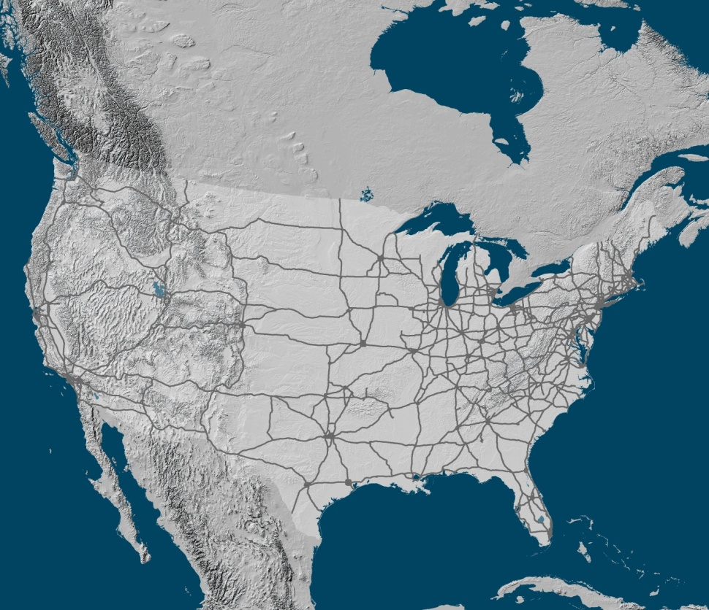
Megaregions:
The Physical and Functional Delineation of Megaregions
Catherine L. Ross, PhD
Myungje Woo, PhD
Jason Barringer, AICP
Center for Quality Growth and Regional Development
Georgia Institute of Technology
October 1-4, 2009
© 2009 by CQGRD. All rights reserved. Please do not quote. This document is under review by the U.S. DOT FHWA.

Slide 5
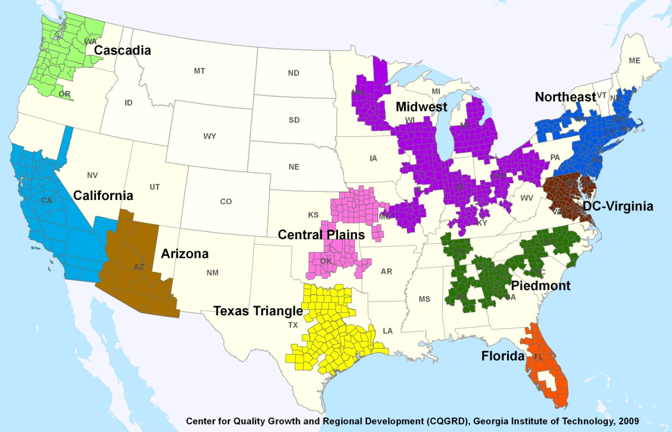
US MEGAREGIONS

Slide 6
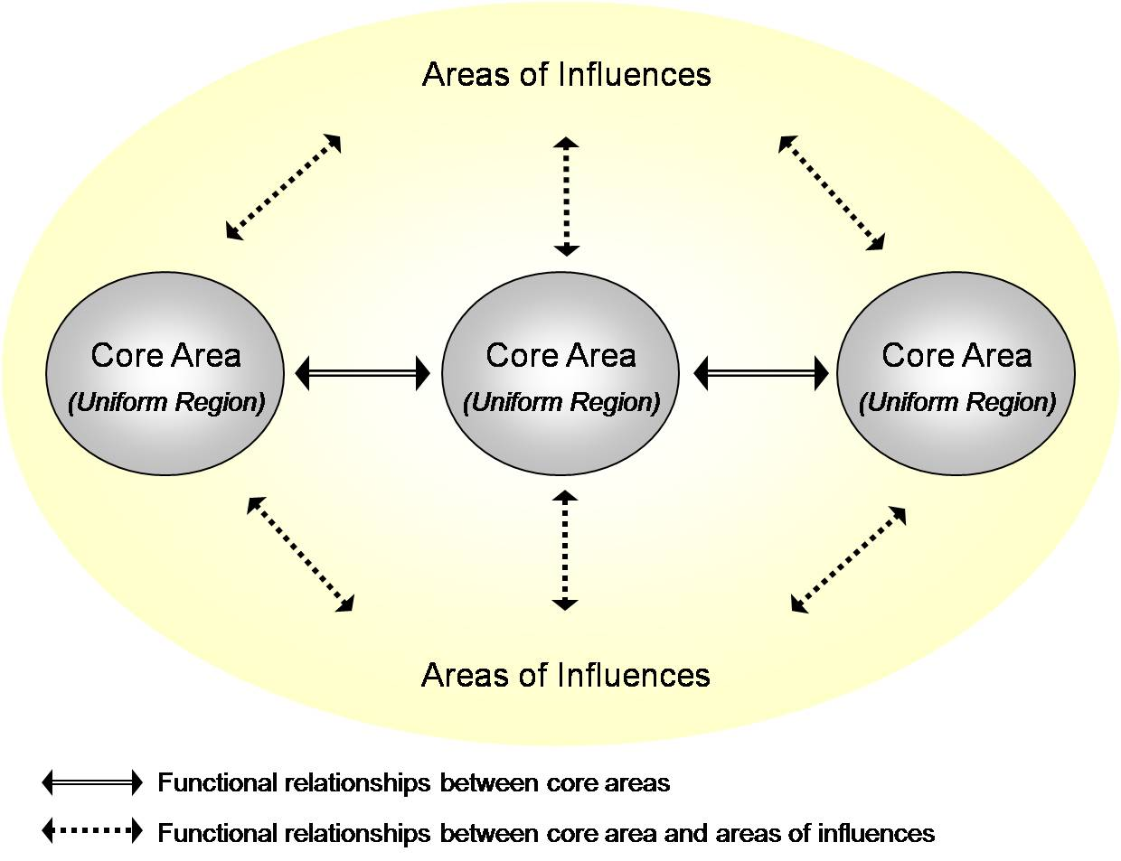
Spatial Structure of Megaregions, Ross and Woo, 2009

Slide 7
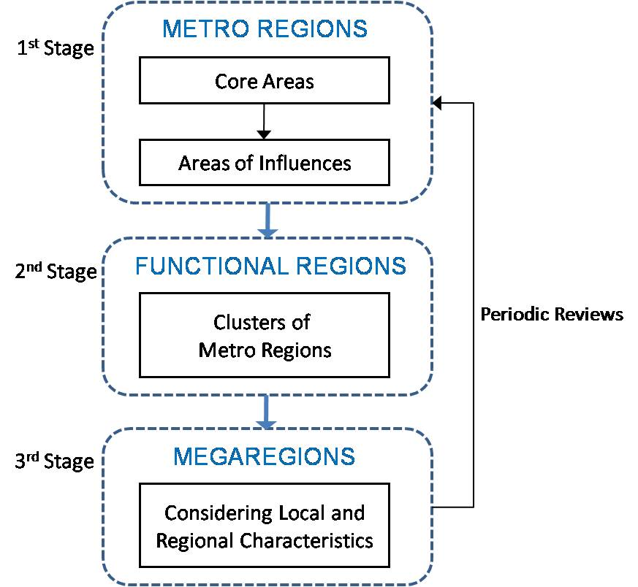
Modeling Megaregions
3. Procedure of Delineating Megaregions
Metro Regions: measuring centrality
Functional Regions: measuring interactions
Megaregions: considering physical relationships
Notes:
The procedure of delineating megaregions includes three stages.
First, we identify metroregions which include both core areas and their areas of influences.
Second, identified metroregions are grouped based on the extent of their interactions (commodity flows), forming functional regions.
Finally, functional regions are be reviewed with contiguity and proximity conditions and then those meeting such conditions are designated as megaregions.
Megaregion boundaries should be reviewed periodically to reflect changes in centrality and functional relationships and local opinions.

